Slide 1
What can we do with TypeScript 2.5?
Presenter: Trong Tran
09 - 2017

Slide 2
Agenda
Introduction TypeScript
Getting started with TypeScript
What can we do with TypeScript 2.5?
Demo

Slide 3
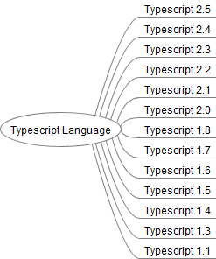
TypeScript Version

